Slide 1
Computer Communication
Networks
Lecture 3
Instructor: Rina Zviel-Girshin

Slide 2
Lecture overview
HTTPS
DNS
Transport Layer
FTP

Slide 3
What Is HTTPS?
Hyper Text Transfer Protocol Secure.
RFC 2818 2660 mid 1990.
Protocol enabling the secured transmission of Web pages.
  HTTPS is not, strictly, a separate protocol, as the data is still transferred using HTTP.
HTTP Over SSL.
SSL - Secure Sockets Layers.
  A protocol developed by Netscape for securing data sent by the browser by means of encryption.

Slide 4
How does it work?
Instead of using a plain text communication, the data is encrypted using a version of the Secure Socket Layer (SSL) or Transport Layer Security (TLS) protocols.
This way customers receive reasonable protection from eavesdroppers and other attacks.
HTTPS uses TCP.
The default port for https is 443 (for unsecured HTTP, the default is 80).

Slide 5
What is encryption?
Encryption is an algorithmic scheme that encodes a plain text message into non-readable form (so called cyphertext).
The receiver of the cyphertext uses a “key” to decrypt the message.
The key is the trigger mechanism to the algorithm.
Eavesdroppers see only an unreadable gibberish – a cyphertext.
Original
Message
key1
Cyphertext
key2
Original
Message

Slide 6
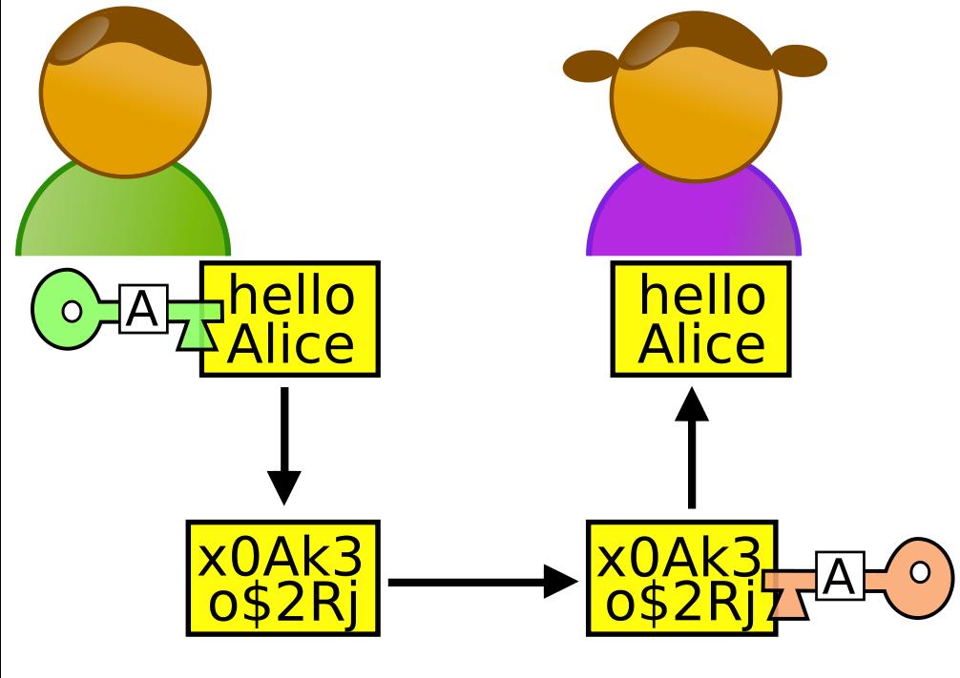
Two types of cryptosystems
Symmetric
  the same key is used
  also called secret key encryption
Asymmetric
  Different keys are used
  Public and private key
  also called public key encryption
Bob
Alice

Slide 7
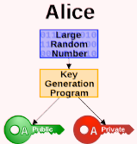
Asymmetric key creation
Choose two large random prime numbers.
Multiply them – some number N.
Using a well known algorithm – RSA - compute public and private keys from that very large number N.

Slide 8
Why now?
Before the Internet encryption was rarely used by the public.
However it was largely used military tool.
Today online marketing, banking and other services require privacy in communication.
Web browsers encrypt any text automatically when connected to a secure server, evidenced by an address beginning with https.
The server decrypts the text upon its arrival.

Slide 9
Transport Layer Security
TLS is composed of two layers:
  the TLS Record Protocol and
  the TLS Handshake Protocol.
The TLS Record Protocol provides connection security with some encryption method such as the Data Encryption Standard (DES) using a symmetric key.
The TLS Handshake Protocol allows (using certificates from trusted servers)
  the server and client to authenticate each other and
  to negotiate an encryption algorithm and
  cryptographic keys before data is exchanged.

Slide 10
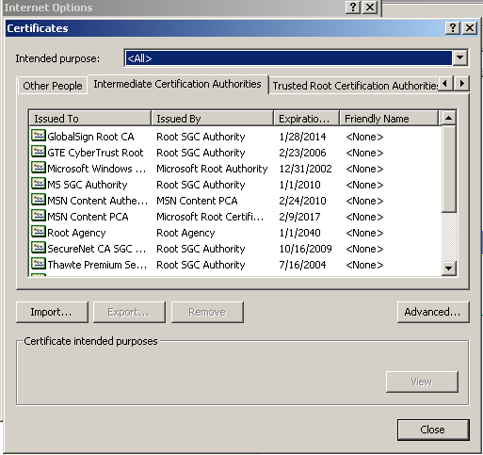
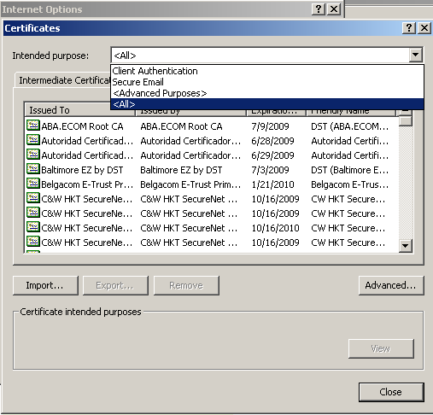
Browser

Slide 11
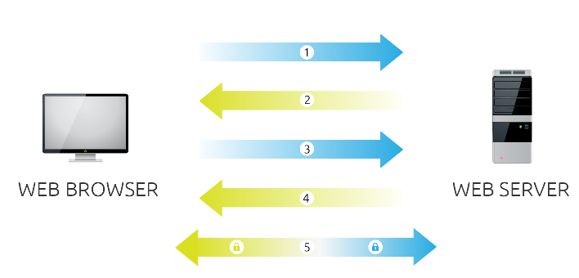
HTTPS
– 5 steps
Browser connects to a server secured with SSL (https) and requests that the server identify itself.
Server sends a copy of its SSL Certificate, including the server’s public key – P_{s}⁺
  Steps 1 and 2 are called web server authentication .
Browser checks the Certificate root against a list of trusted CAs (unexpired, unrevoked, etc).
  If OK - browser uses a secret key algorithm and creates, encrypts, and sends back a symmetric session key K using the server’s public key Ps+(K).

Slide 12
HTTPS
– 5 steps
Server decrypts the K using its private key - P_{s}⁻(P_{s}⁺(K)) and sends back an acknowledgement encrypted with the session key K to start the encrypted session.
Server and Browser now encrypt all transmitted data with the session key.

Slide 13
Encrypted SSL session
  Browser
    generates a symmetric session key,
    encrypts it with server’s public key (received from the third party - trusted servers),
    sends encrypted key to the server.
  Server uses its private key (asymmetric keys algorithm), decrypts a session key.
  Browser and server know a session key
    All data sent into TCP socket (by client or server) is encrypted with this session key.

Slide 14
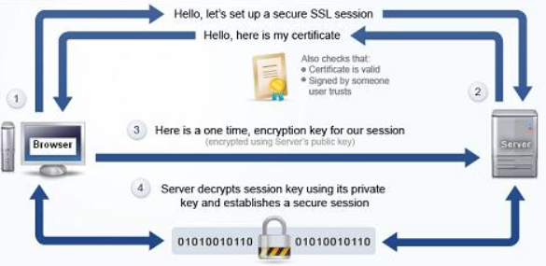
Once more

Slide 15
DNS query
The internet’s directory service – translates hostnames to IP addresses
DNS protocol is utilized to identify servers by their IP addresses and aliases given their registered name.
Port 53
Browser
DNS query
DNS server
URL
Origin server
TCP Connection
HTTP Request
HTTP Response
Optional parallel connections

Slide 16
DNS server
The program that translates symbolic URL's to physical IP addresses is called “DNS server” - Domain Name System/Service
Exist since 1983. RFC 882
When a new server comes to life, it’s name is recorded on a special table called DNS table.
DNS table - is a distributed and dynamic database implemented in hierarchy of many name servers.

Slide 17
DNS table
DNS table contains the symbolic names of all the registered Web servers in the world.
The DNS tables are replicated in many locations all over the world.
A special robot program updates DNS tables continuously.

Slide 18
Domain name
Domain name is a name that identifies one or more IP addresses.
For example, the domain name microsoft.com represents about a dozen IP addresses.
Domain names are used in URLs to identify particular Web pages.
DNS is used mostly to translate between domain names and IP addresses.

Slide 19
DNS: other important services
Host aliasing
  A single host can have several alias names
Mail server aliasing
  A company’s mail server and Web server may have identical (aliased) hostnames
Load distribution
  Busy sites, such as cnn.com, are replicated over multiple servers having different IP addresses

Slide 20
DNS Domain name servers
Why not centralize DNS?
single point of failure
traffic volume
distant centralized database
maintenance

Slide 21
DNS network
The DNS system is, in fact, a network.
No server has all name-to-IP address mappings.
If one DNS server doesn't know how to translate a particular domain name, it asks another one, and so on, until the correct IP address is returned.

Slide 22
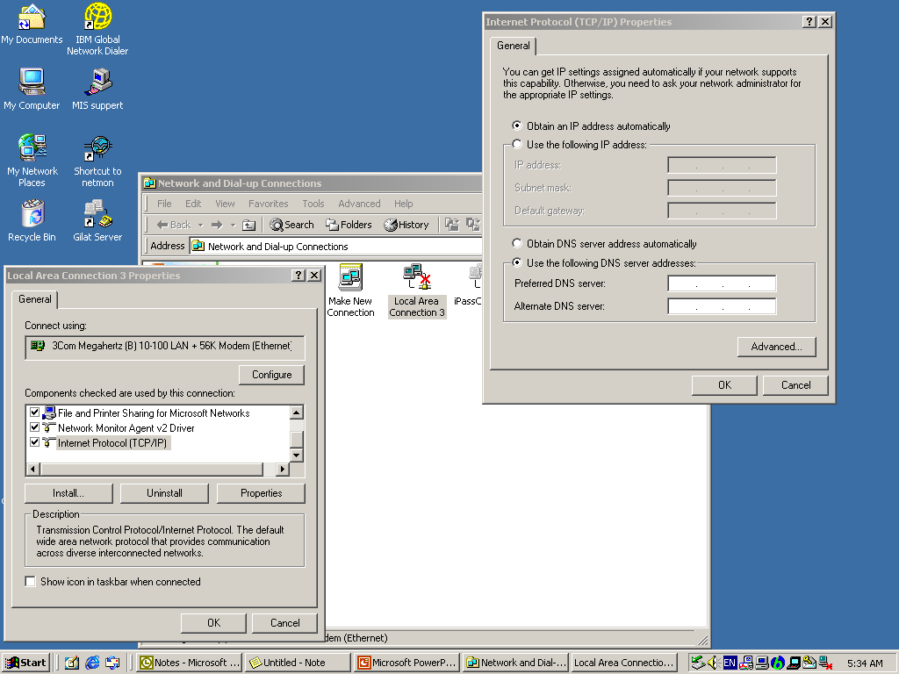
Configuring your DNS

Slide 23
DNS structure
The DNS consists of a hierarchical set of DNS servers.
Each domain or sub-domain has one or more authoritative DNS servers that publish information about that domain.
The hierarchy of authoritative DNS servers matches the hierarchy of domains.
At the top of the hierarchy stand the root servers: the servers to query when looking up (resolving) a domain name.

Slide 24
DNS hierarchy
Local name servers:
  each ISP, company has local (default) name server
  host DNS query first goes to local name server
Authoritative name server:
  for a host: stores that host’s IP address, name
  can perform name/address translation for that host’s name
  Many name servers act as both local and authoritative
Root name server
  Knows the IP address of an “authoritative name server’’.

Slide 25

DNS: Root name servers
Contacted by local name server that can not resolve name
Root Name Server:
  contacts authoritative name server if name mapping not known (knows the IP address of each second-level DNS server)
  gets mapping
  returns mapping to local name server
a NSI Herndon, VA
c PSInet Herndon, VA
d U Maryland College Park, MD
g DISA Vienna, VA
h ARL Aberdeen, MD
j NSI (TBD) Herndon, VA
k RIPE London
i NORDUnet Stockholm
m WIDE Tokyo
e NASA Mt View, CA
f Internet Software C. Palo Alto, CA
13 root name servers worldwide
b USC-ISI Marina del Rey, CA
l ICANN Marina del Rey, CA

Slide 26
DNS hierarchy
  The set of all possible names is divided into mutually exclusive portions:
    TLD - top-level domain (com,edu,il)
    Sub-domain (ac, cnn, co)
    And ect
  A higher authority assigns each naming authority a unique prefix
root
com
edu
il
ac
co
idc

Slide 27
DNS example
For the DNS server of cnn.com to translate cs.idc.ac.il to access:
  (1) the root DNS
  (2) the .il DNS
  (3) the ac.il DNS
  (4) the idc.ac.il DNS
Every DNS server knows the IP address of the root server.

Slide 28
DNS request
A DNS request message is sent over TCP or UDP port 53.
Almost all DNS queries consist of a single UDP request from the client followed by a single UDP reply from the server.
  UDP requires the server to perform its own time-out and retransmission scheme.
TCP is typically used only when the response data size exceeds 512 bytes.

Slide 29

Simple DNS example
root name server
Host surf.eurecom.fr wants IP address of gaia.cs.umass.edu
1. Contacts its local DNS server, dns.eurecom.fr
2. dns.eurecom.fr contacts root name server, if necessary
3. root name server contacts authoritative name server, dns.umass.edu, if necessary
2
4
5
3
local name server
dns.eurecom.fr
authoritative name server
dns.umass.edu
1
6
requesting host
surf.eurecom.fr
gaia.cs.umass.edu

Slide 30
Authoritative Name Servers
System Administrators at cnn.com setup their 4 authoritative DNS servers.
Authoritative DNS servers are the "authority" for any questions regarding the domain name to IP address mappings for cnn.com.
Authoritative name servers for www.cnn.com can also answer the following questions:
  Which hosts are responsible for receiving the email for cnn.com? (What are the MX records for cnn.com)?
  Which name servers are authoritative for cnn.com? (What are the NS records for cnn.com)?
  Convert a cnn.com domain name into an IP address? (what is an A record)?

Slide 31
DNS example
root name server
2
6
Root name server:
may not know authoritative name server
may know intermediate name server: who to contact to find an authoritative name server
7
3
local name server
dns.eurecom.fr
intermediate name server
dns.umass.edu
4
5
1
8
authoritative name server
dns.cs.umass.edu
requesting host
surf.eurecom.fr
gaia.cs.umass.edu

Slide 32
DNS: iterated queries
root name server
2
iterated query
3
recursive query:
puts burden of name resolution on contacted name server
heavy load?
iterated query:
contacted server replies with name of server to contact
“I don’t know this name, but ask this server”
4
7
local name server
dns.eurecom.fr
intermediate name server
dns.umass.edu
5
6
1
8
authoritative name server
dns.cs.umass.edu
requesting host
surf.eurecom.fr
gaia.cs.umass.edu

Slide 33
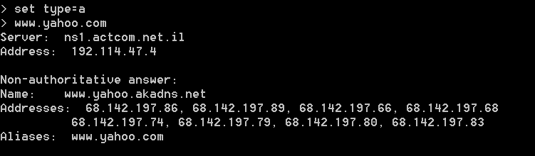
DNS query example
Query type A returns an IP address of the domain.
The type is the query type.

Slide 34
DNS: caching and updating records
once (any) name server learns mapping, it caches mapping
  cache entries timeout (disappear) after some time
update/notify mechanisms under design by IETF
  RFC 2136
  http://www.ietf.org/html.charters/dnsind-charter.html

Slide 35
Transport layer
Two basic protocols:
  TCP - Transmission Control Protocol
    RFCs: 793, 1122, 1323, 2018, 2581
  UDP - User Datagram Protocol
    RFC 768

Slide 36
Services provided by Internet Transport protocols
TCP service:
connection-oriented: setup required between client, server
reliable transport between sending and receiving process
flow control: sender won’t overpower, flood receiver
traffic control: reduce the speed of the sender when network overloaded
does not providing: timing, minimum bandwidth guarantees
UDP service:
unreliable data transfer between sending and receiving process
does not provide:
  connection setup,
  reliability,
  flow control,
  traffic control,
  timing,
  or bandwidth guarantee

Slide 37
What transport service does an application need?
Data loss
some apps (e.g., audio) can tolerate some loss
other apps (e.g., file transfer, telnet) require 100% reliable data transfer
Bandwidth
some apps (e.g., multimedia) require minimum amount of bandwidth to be “effective”
other apps (“elastic apps”) make use of whatever bandwidth they get
Timing
some apps (e.g., Internet telephony, interactive games) require low delay to be “effective”

Slide 38
Transport service requirements of common apps
Application
File Transfer
E-Mail
Web documents
Real-time Audio/Video
Interactive Games
Data loss
no loss
no loss
loss-tolerant
loss-tolerant
loss-tolerant
Bandwidth
elastic
elastic
elastic
audio: 5Kb-1Mb
video:10Kb-5Mb
few Kbps up
Time Sensitive
no
no
no
yes, 100’s msec
yes, 100’s msec

Slide 39
Internet apps: their protocols and transport protocols
Application
layer protocol
smtp [RFC 821]
telnet [RFC 854]
http [RFC 2068]
ftp [RFC 959]
proprietary
(e.g. RealNetworks)
NSF
proprietary
(e.g., Vocaltec)
Underlying
transport protocol
TCP
TCP
TCP
TCP
TCP or UDP
TCP or UDP
typically UDP
Application
E-mail
Remote terminal access
Web
File transfer
Streaming multimedia
Remote file server
Internet telephony

Slide 40
FTP
FTP stands for File Transfer Protocol (documented in RFC 959).
FTP is one of oldest Internet protocols still in widespread use.
FTP is implemented using the TCP.
Provides facilities for transferring to and from remote computer systems.

Slide 41

FTP: File Transfer Protocol
FTP
user
interface
FTP
client
file transfer
FTP
server
user
at host
remote file
system
local file
system
Transfer file to/from remote host
client/server model
  client: side that initiates transfer (either to/from remote)
  server: remote host
1971, RFC 959
ftp server: port 21

Slide 42
FTP connections
During an FTP session there will be two separate network connections one between client and server:
  control connection
  data connection.
The control and data connections use TCP.
In normal Internet operation the FTP server listens on the well-known port number 21 for control connection requests.
Usually the user transferring a file needs authority to login and access files on the remote system (authentication).

Slide 43
ftp: separate control, data connections
FTP client contacts FTP server at port 21, specifying TCP as transport protocol
Two parallel TCP connections opened:
  control: exchange commands, responses between client, server.
    “out of band control”
  data: file data to/from server
Control connection remain open
Data connection is created for each file transfer.
FTP server maintains “state”: current directory, earlier authentication
TCP control connection
port 21
FTP
client
TCP data connection
port 20
FTP
server

Slide 44
ftp commands, responses
Sample commands:
sent as ASCII text over control channel
USER username
PASS password
LIST return list of file in current directory
RETR filename retrieves (gets) file
STOR filename stores (puts) file onto remote host
Sample return codes
status code and phrase (as in http)
331 Username OK, password required
125 data connection already open; transfer starting
425 Can’t open data connection
452 Error writing file

Slide 45
Getting Started
  To connect your local machine to the remote machine, type ftp machinename
  or if the name of the machine is unknown, you may type ftp machinennumber
  where machinennumber is the net address of the remote machine, e.g., 129.82.45.181.
  If the remote machine has been reached successfully, FTP responds by asking for a loginname and password.
  When you enter your own loginname and password for the remote machine, it returns the prompt ftp>
  Now you may access your own home directory on the remote machine.

Slide 46
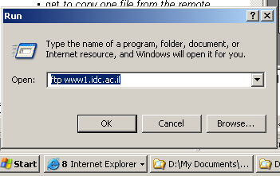
Example
ftp machinename

Slide 47
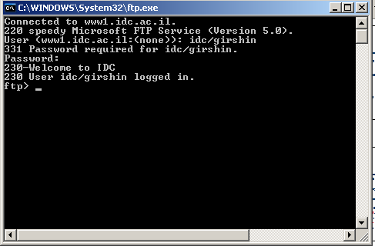
Example
Authentication stage:

Slide 48
Some common FTP Commands
? to request help or information about the FTP commands
cd to change directory on the remote machine
ls to list the names of the files in the current remote directory
mkdir to make new directory within the current remote directory
pwd to find out the pathname of the current directory on the remote machine
get to copy one file from the remote machine to the local machine
send or put to copy one file from the local machine to the remote machine
delete to delete a file in the current remote directory
quit to exit the FTP environment

Slide 49

Any questions?

